Slide 1


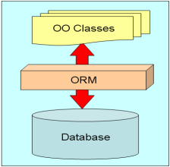

ORM Basics
Repository Pattern, Models, Entity Manager
Web Development Basics
Ivan Yonkov
Technical Trainer
Software University
http://softuni.bg

Slide 2

Table of Contents
ORM Technologies – Basic Concepts
Data Access Classes
Repository Pattern
Examining DB Schema
Mapping Tables to Classes
Entity Manager

Slide 3
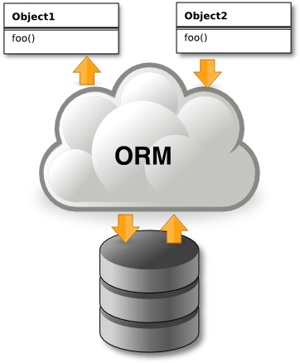
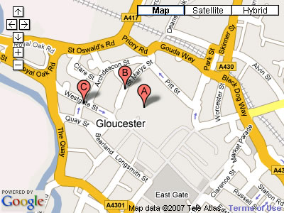


Introduction to ORM Technologies
What is Object-Relational Mapping (ORM)?

Slide 4
ORM Technologies
Object-Relational Mapping (ORM) is a programming technique for automatic mapping data and schema
Between relational database tables and object-oriented classes and objects
ORM creates a "virtual object database"
Can be used from within the programming language (C# or Java…)
ORM frameworks automate the ORM process
A.k.a. Object-Relational Persistence Frameworks

Slide 5
ORM Frameworks
ORM frameworks typically provide the following functionality:
Creating object model by database schema (DB first model)
Creating database schema by object model (code first model)
Querying data by OO API (e.g. LINQ queries, Criteria API)
Data manipulation operations
CRUD – create, retrieve, update, delete
ORM frameworks automatically generate SQL to perform the requested data operations

Slide 6
ORM Advantages and Disadvantages
Object-relational mapping (ORM) advantages
Developer productivity: writing less code
Abstract from differences between object and relational world
Complexity hidden within the ORM
Manageability of the CRUD operations for complex relationships
Easier maintainability
Disadvantages:
Reduced performance (due to overhead or incorrect ORM use)
Reduces flexibility (some operations are hard for implementing)

Slide 7

Data Access Layer

Slide 8
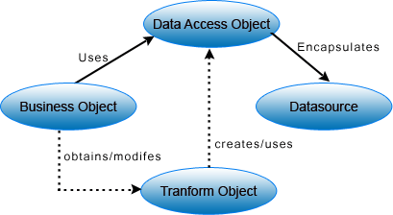
Data Access Layer
Data Access Layer (DAL) is a layer of an application which simplifies access to data in a persistent storage (database, files…)
Usually done in an object oriented manner where an object returns necessary persisted data

Slide 9
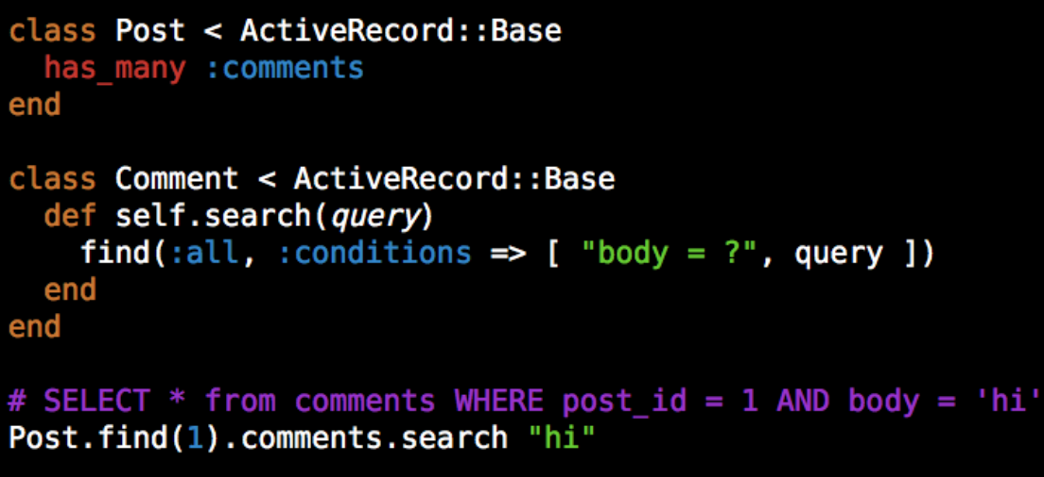
Data Access Layer (2)
In applications where DAL is implemented in order to build an ORM, it usually implements the Active Record Pattern
Active Record Pattern obligates objects to provide interface for common CRUD operations
Insert
Delete
Update
Reads data by specifying columns and values

Slide 10
Data Access Layer (3)
Pseudo code of an Active Record Object API
$user = new User();
$user->insert([“name” => “Ivan”, “nickname” => “RoYaL”]);
$user->save();
$user = Users::findFirst(“nickname”, “RoYaL”);
$user->update(“email”, ivan@gmail.com);
$user->update(“age”, “22”);
$user->save();
$users = Users::findAll(“name”, “pesho”);
$users->delete();

Slide 11
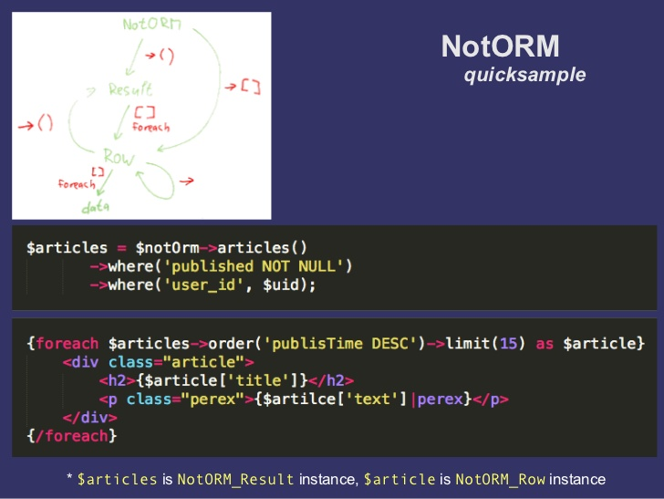
Data Access Layer (4)

Slide 12
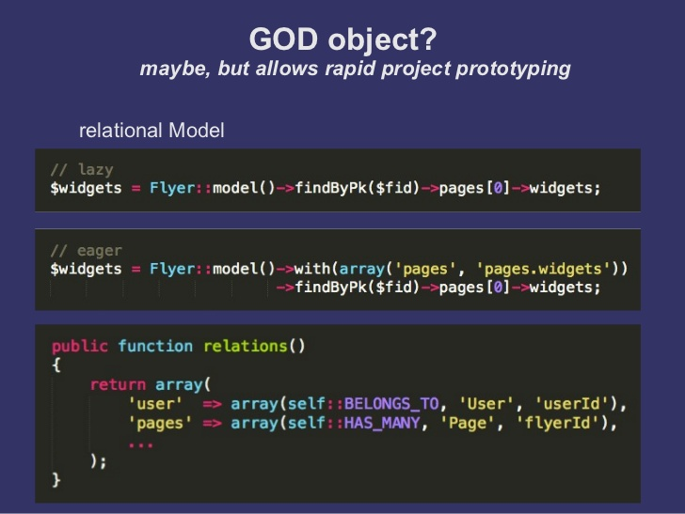
Data Access Layer (5)

Slide 13

Repository Pattern

Slide 14
Repository Pattern
The Repository Pattern upgrades the Active Record in terms of Data Access in order to provide strong object oriented access to Data Access Objects Access Objects (a.k.a Entities)
Objects implementing the pattern usually have methods for querying the data different ways and methods for finalizing the query
filterById(), filterByUsername(), filterByEmail()
findOne(), find(), delete()

Slide 15
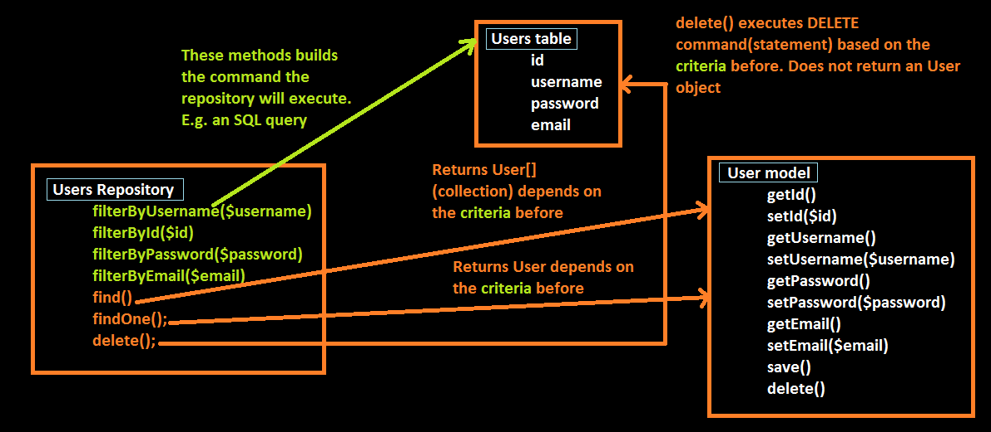
Repository Pattern (1)

Slide 16
Repository Pattern (2)
$repository = new UsersRepository();
$users = $repository
->filterByUsername(“ivan”)
->find(); // returns User[]
foreach ($users as $user) {
$user->setEmail(“admin@example.com”)-save();
}
$repository->filterByUsername(“pesho”)->delete(); // deletes all peshos
$abv = $repository->filterByEmail(Criteria::ENDS_WITH, “@abv.bg”)
foreach ($abv as $user) {
echo $abv->getUsername() . “<br />”;
}

Slide 17
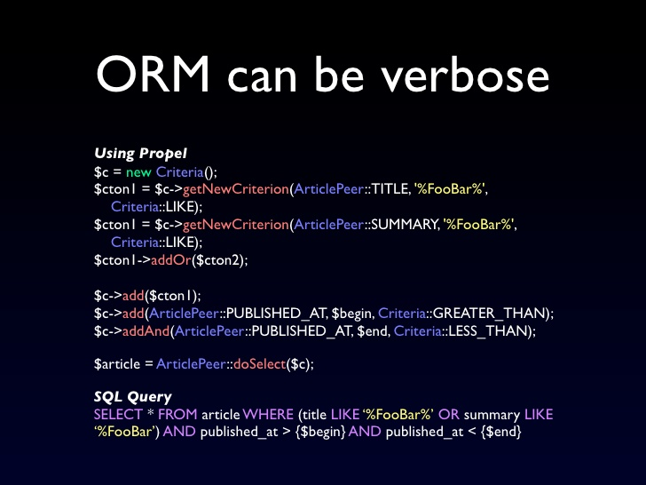
Repository Pattern (3)

Slide 18

Examining Database Schema
Getting Table Names and Metainformation

Slide 19
Examining Database Schema
In order to create repository classes we need to examine the database schema.
It’s hard and unmaintainable to do it manually
Every time the schema changes, the classes need to change their interface as well
The process have to be automated somehow

Slide 20
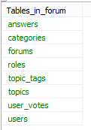
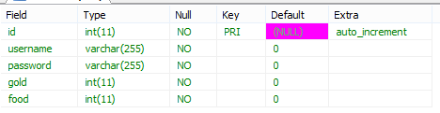
Examining Database Schema (1)
Getting table names in MySQL
SHOW TABLES;
Getting columns meta information
SHOW COLUMNS FROM `tableName`;

Slide 21


Mapping Tables to Classes

Slide 22
Mapping Tables to Classes
New files have to be created via file_put_contents() or fwrite()
Files represent one repository and one model per table
Table names are got from the SHOW TABLES; statement
Looping over table columns to create filtering methods in the Repository and properties in the Model
Common logic is abstracted.

Slide 23
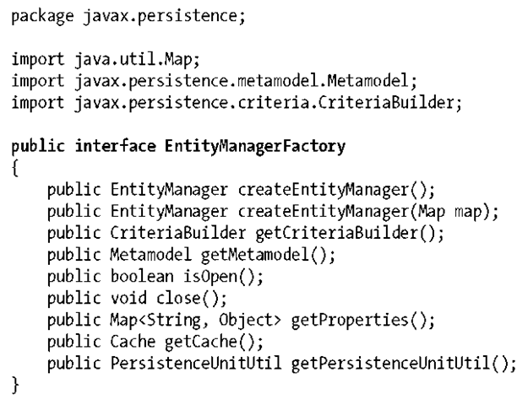
Entity Manager

Slide 24
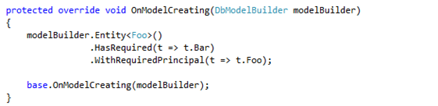
Entity Manager
Entity Manager is an object that is associated with a persistent context
Maintains the repositories and entities
Attaches, detaches entities
Exposes fluent API

Slide 25
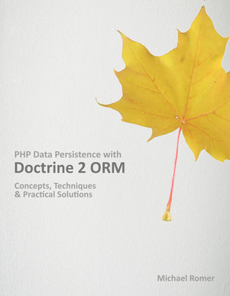
Resources
PHP Data Persistence With Doctrine ORM (M. Romer)

Slide 26










ORM Basics
https://softuni.bg/courses/web-development-basics/

Slide 27
License
This course (slides, examples, demos, videos, homework, etc.) is licensed under the "Creative Commons Attribution-NonCommercial-ShareAlike 4.0 International" license

Slide 28






Free Trainings @ Software University
Software University Foundation – softuni.org
Software University – High-Quality Education, Profession and Job for Software Developers
softuni.bg
Software University @ Facebook
facebook.com/SoftwareUniversity
Software University @ YouTube
youtube.com/SoftwareUniversity
Software University Forums – forum.softuni.bg

